Slide 1
NSF/NASA
The role of taxonomic, functional, genetic, and landscape diversity in food web responses to a changing environment
2013-2018
Anthony R. Ives, UW-Madison
Volker C. Radeloff, UW-Madison
Kerry M. Oliver, University of Georgia
Jason P. Harmon, North Dakota State University
Notes:
Constrast to yesterday - theory vs. empirical
Strange talk - not going to talk about stuff that I’ve done - lab talk
Collected 12 talks given by people in the lab - condensed down to a single talk
You might be thinking that you are about to experience a 3 hour train wreck - I really did shortened things, so the train wreck should last less than 1 hour

Slide 2
Dimensions of Biodiversity
Functional diversity
Taxonomic diversity
Genetic and phylogenetic diversity
Landscape diversity
Notes:
Constrast to yesterday - theory vs. empirical
Strange talk - not going to talk about stuff that I’ve done - lab talk
Collected 12 talks given by people in the lab - condensed down to a single talk
You might be thinking that you are about to experience a 3 hour train wreck - I really did shortened things, so the train wreck should last less than 1 hour

Slide 3
Outline
Study system
What we want from remote sensing
Notes:
Constrast to yesterday - theory vs. empirical
Strange talk - not going to talk about stuff that I’ve done - lab talk
Collected 12 talks given by people in the lab - condensed down to a single talk
You might be thinking that you are about to experience a 3 hour train wreck - I really did shortened things, so the train wreck should last less than 1 hour

Slide 4
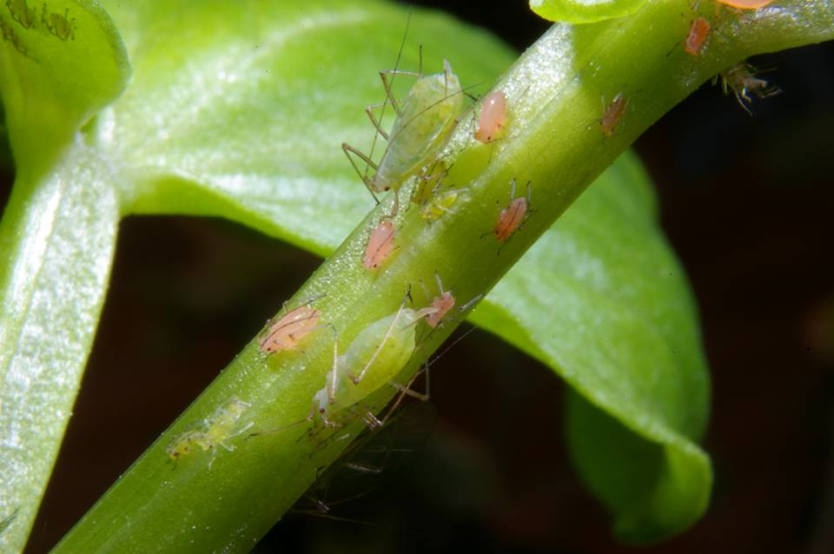
Pea aphids
pests of alfalfa, beans, and peas
parthenogenic
have two color morphs

Slide 5
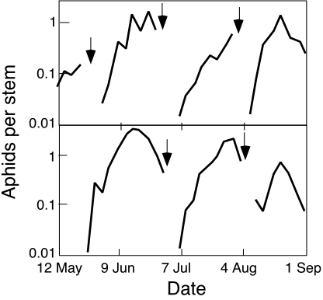
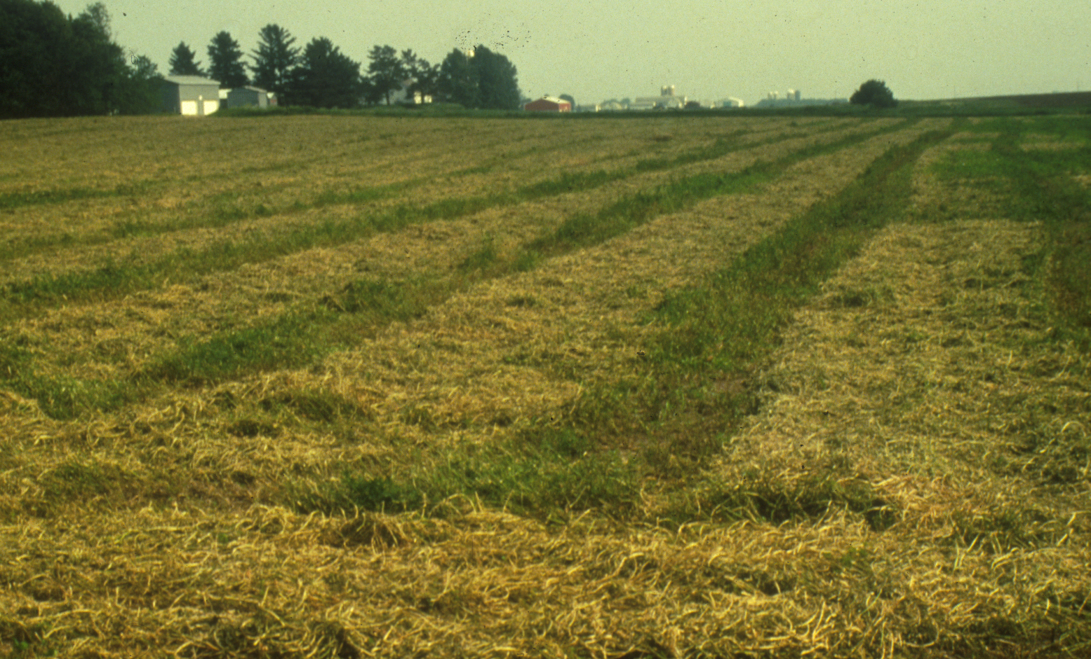
Biological control
two fields over one summer
Notes:
Keeps me up at night

Slide 6
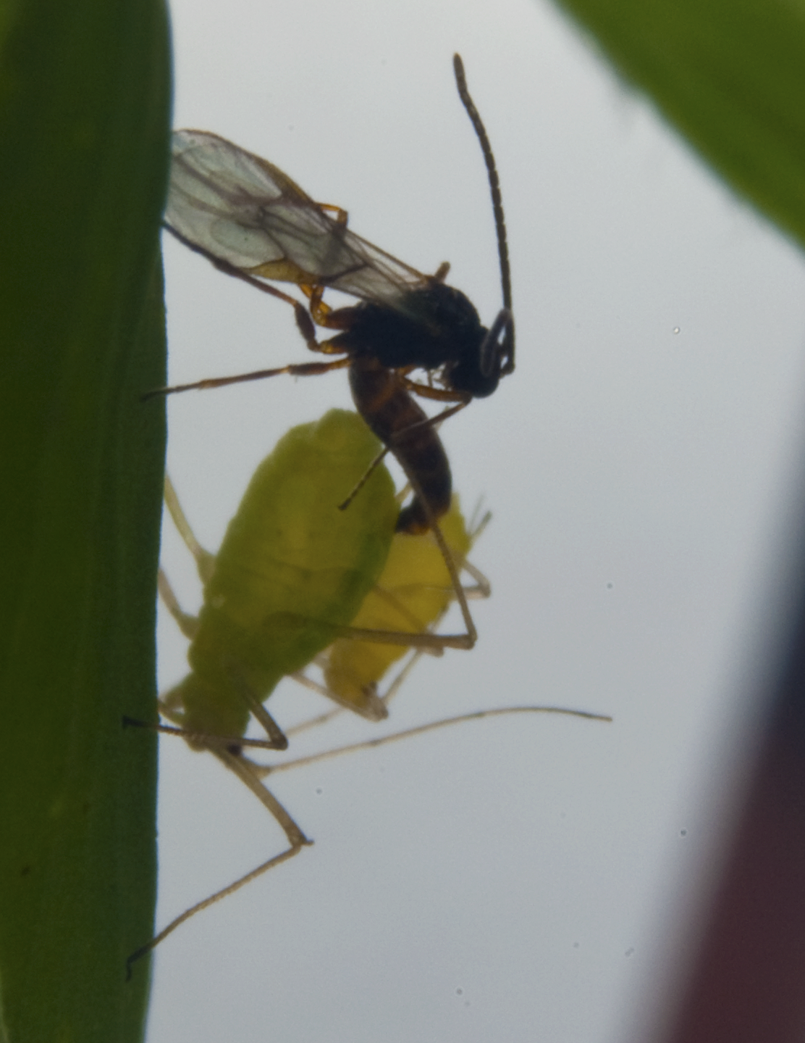
Aphidius ervi
solitary parasitoid
larvae eat aphids from the inside out
introduced in the 1950s for biological control
specialist on pea aphids

Slide 7
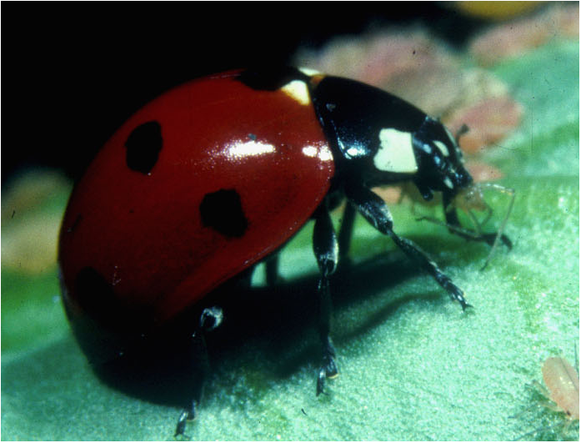
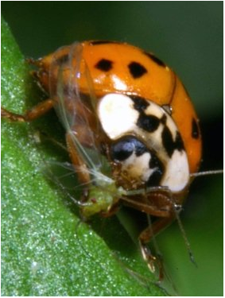
Ladybeetles
C7
Coccinella septempunctata
Europe/Asia
Harmonia
Harmonia axyridis
Asia

Slide 8
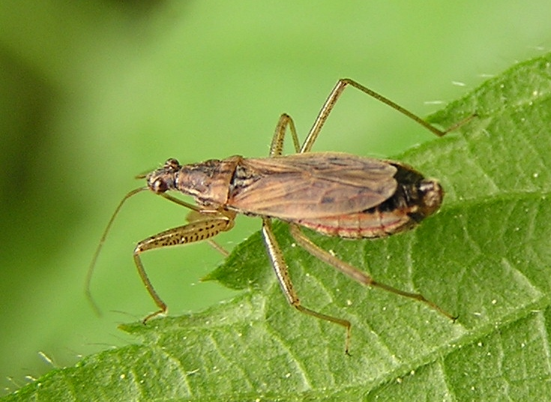
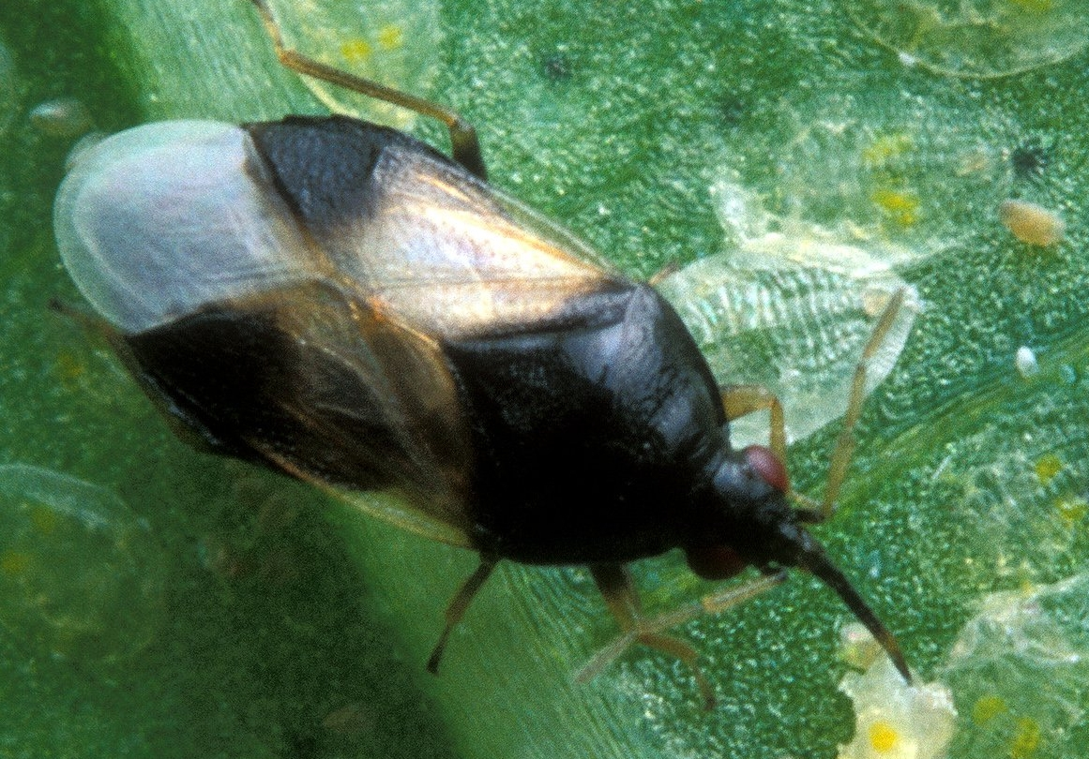
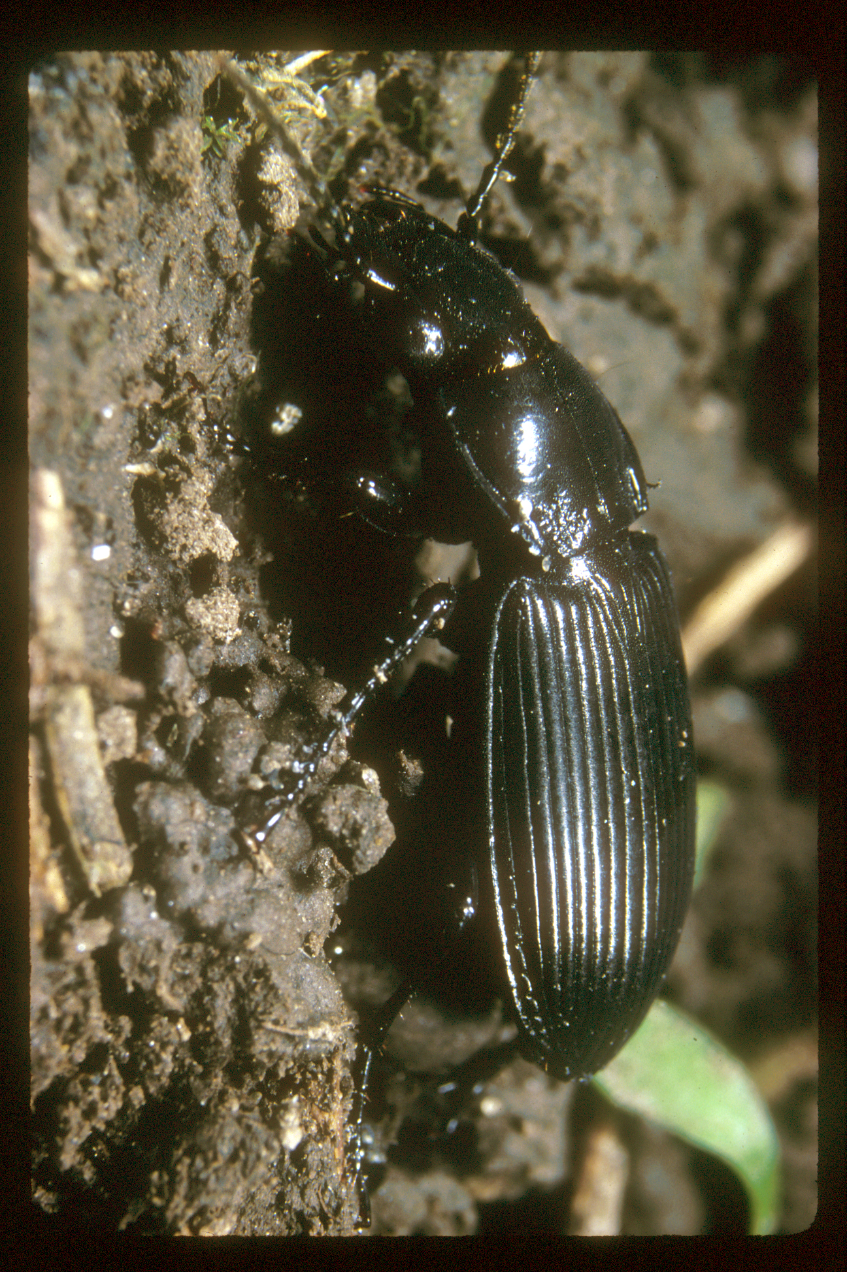
Generalist predators
Nabids (Nabis)
Minute pirate bugs (Orius)
Ground beetles (Carabidae)
Pathogens
Fungal
Viral

Slide 9
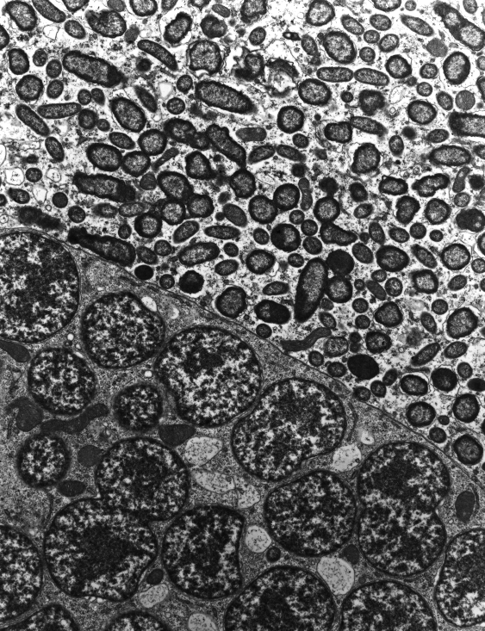
Bacterial symbionts
found in many tissues
infect most insect species
heritable

Slide 10
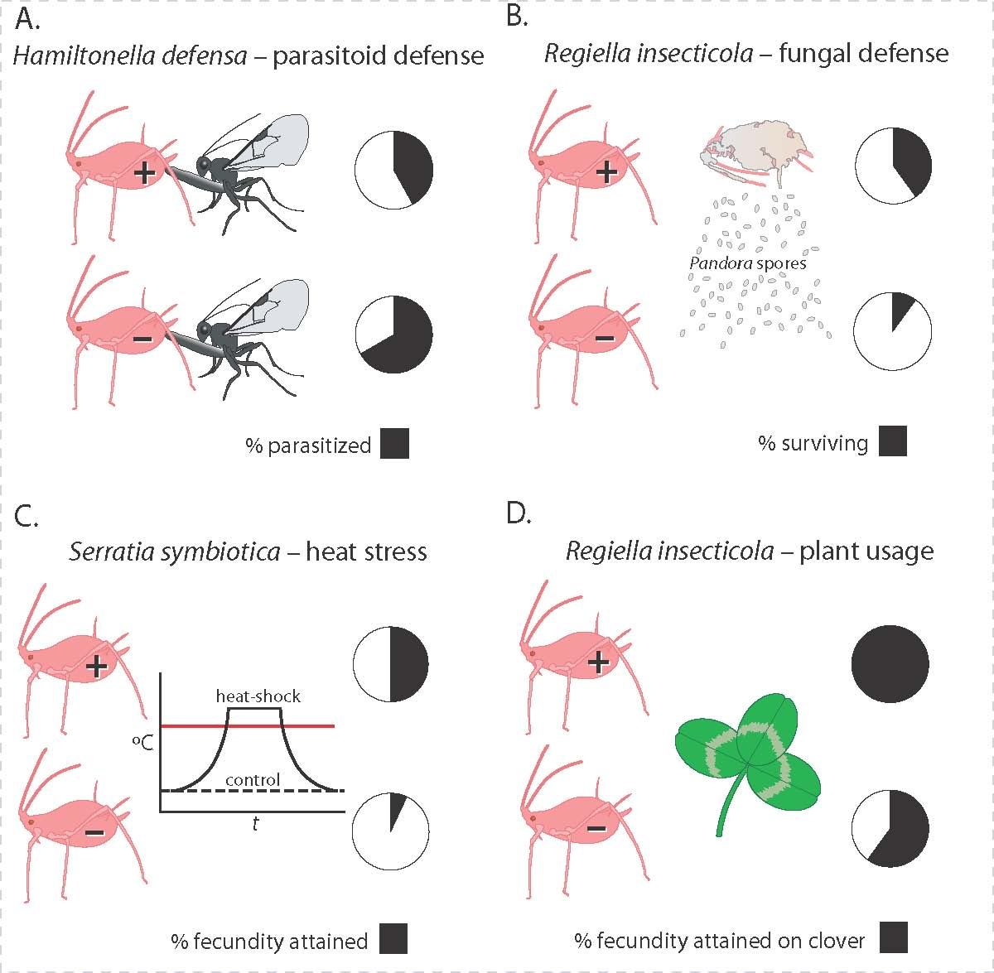
Pea aphid model system
Oliver et al. (2010 Ann. Rev. Entomol.)

Slide 11
Evolution of heat-shock tolerance
“Custom-made” aphid clones that differed in sensitivity to heat shocks
sensitive | tolerant
red | green
green | red

Slide 12
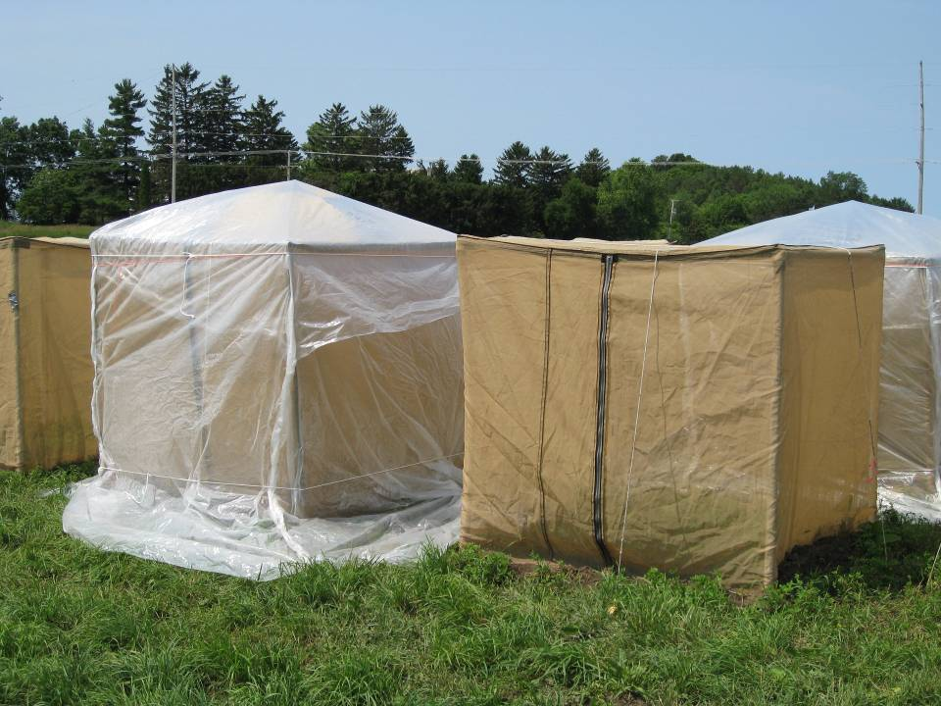
Field experiments
Rapid evolution of tolerance
Effect on population depends on the presence and species of predators
Some predators just eat the abundant, tolerant aphids, so evolution is a wash
35
Temperature
20
8:00
20:00
8:00

Slide 13
Outline
Study system
What we want from remote sensing
Notes:
Constrast to yesterday - theory vs. empirical
Strange talk - not going to talk about stuff that I’ve done - lab talk
Collected 12 talks given by people in the lab - condensed down to a single talk
You might be thinking that you are about to experience a 3 hour train wreck - I really did shortened things, so the train wreck should last less than 1 hour

Slide 14
Scales through time
Plant (1990-1996)
Alfalfa field (1996-2002)
Notes:
Constrast to yesterday - theory vs. empirical
Strange talk - not going to talk about stuff that I’ve done - lab talk
Collected 12 talks given by people in the lab - condensed down to a single talk
You might be thinking that you are about to experience a 3 hour train wreck - I really did shortened things, so the train wreck should last less than 1 hour

Slide 15
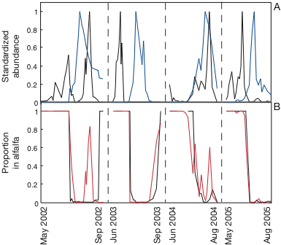
Scales through time
Plant (1990-1996)
Alfalfa field (1996-2002)
Alfalfa and soybean fields (2002-2009)
aphids in: alfalfa soybean
in alfalfa: aphids ladybeetles
Notes:
Constrast to yesterday - theory vs. empirical
Strange talk - not going to talk about stuff that I’ve done - lab talk
Collected 12 talks given by people in the lab - condensed down to a single talk
You might be thinking that you are about to experience a 3 hour train wreck - I really did shortened things, so the train wreck should last less than 1 hour

Slide 16
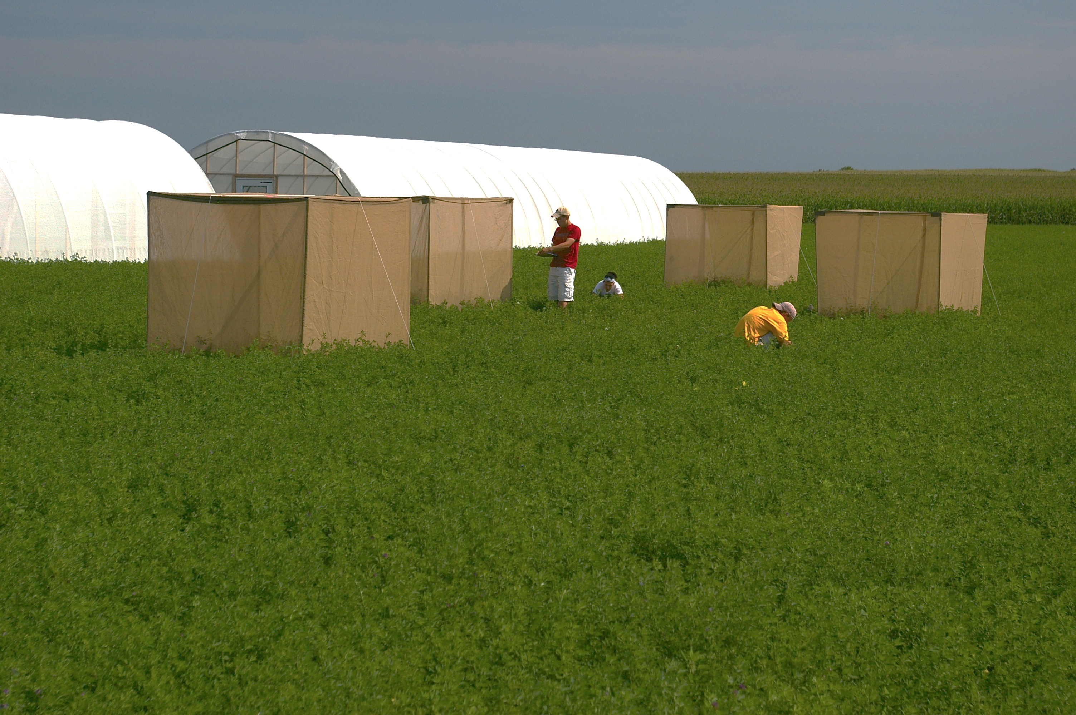
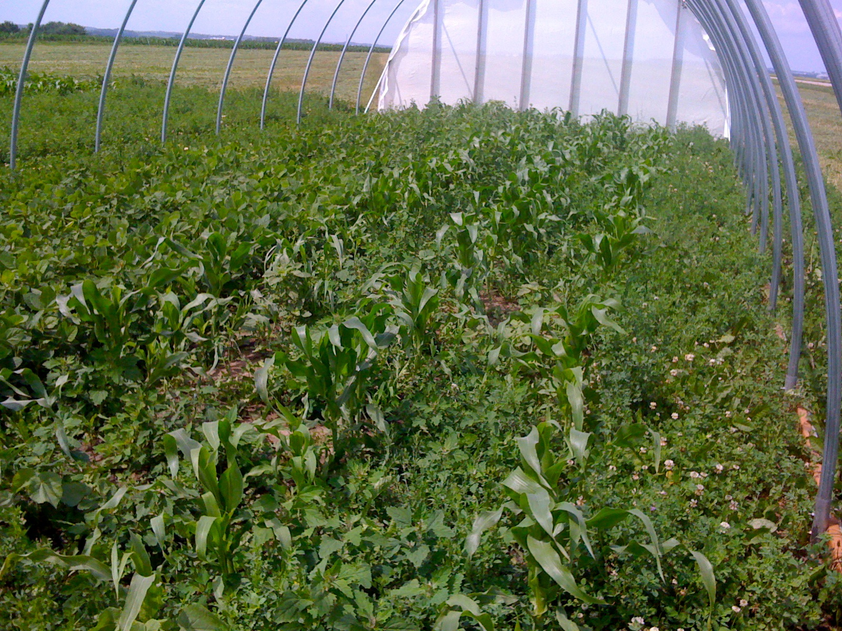
Scales through time
Plant (1990-1996)
Alfalfa field (1996-2002)
Alfalfa and soybean fields (2002-2009)
Alfalfa, soybean and corn (2009-)
Notes:
Constrast to yesterday - theory vs. empirical
Strange talk - not going to talk about stuff that I’ve done - lab talk
Collected 12 talks given by people in the lab - condensed down to a single talk
You might be thinking that you are about to experience a 3 hour train wreck - I really did shortened things, so the train wreck should last less than 1 hour

Slide 17
Proposal
1. How does species diversity affect the resilience of ecosystems?
2. How do within-species genetic diversity (generated by symbiotic relationships) and evolution affect the resilience of food webs?
3. What are the diversity and transmission patterns of symbionts among insects in agricultural systems?
4. Has evolution produced local evolutionary adaptations of aphids to climatic regimes and natural enemies within food webs?
5. Can genetic diversity among pea aphids allow sufficiently rapid evolution to change the resilience of food-web dynamics?
Notes:
Constrast to yesterday - theory vs. empirical
Strange talk - not going to talk about stuff that I’ve done - lab talk
Collected 12 talks given by people in the lab - condensed down to a single talk
You might be thinking that you are about to experience a 3 hour train wreck - I really did shortened things, so the train wreck should last less than 1 hour

Slide 18
Proposal
1. How does species diversity affect the resilience of ecosystems?
2. How do within-species genetic diversity (generated by symbiotic relationships) and evolution affect the resilience of food webs?
3. What are the diversity and transmission patterns of symbionts among insects in agricultural systems?
4. Has evolution produced local evolutionary adaptations of aphids to climatic regimes and natural enemies within food webs?
5. Can genetic diversity among pea aphids allow sufficiently rapid evolution to change the resilience of food-web dynamics?
How do landscape and weather combine with natural enemies to drive dynamics of pea aphids?
What are the regional and continental distributions of symbionts among aphids and other insects?
Notes:
Constrast to yesterday - theory vs. empirical
Strange talk - not going to talk about stuff that I’ve done - lab talk
Collected 12 talks given by people in the lab - condensed down to a single talk
You might be thinking that you are about to experience a 3 hour train wreck - I really did shortened things, so the train wreck should last less than 1 hour

Slide 19
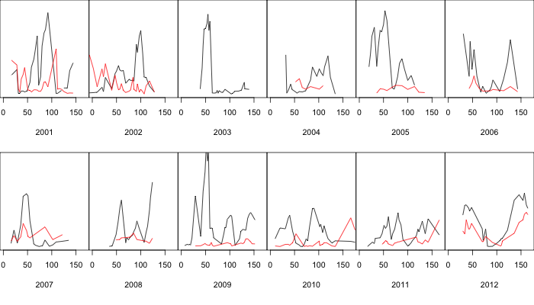
How do landscape and weather combine with natural enemies to drive dynamics of pea aphids?
aphids % parasitism
5 alfalfa fields
log aphid numbers and % parasitism

Slide 20
Research Plan
30 fields: 10 alfalfa, 10 soybean, 10 corn
2x weekly samples of aphids and natural enemies
monthly samples of symbionts
remote sensing for landscape and weather variables

Slide 21
Landsat LDCM and L7 to get crop composition, phenologies, planting, harvesting, NDVI
30 fields to ground truth
interpret and extrapolate patterns from the 30 fields
National Agricultural Statistics Service
Pink=alfalfa
Green=soybean
Orange=corn

Slide 22
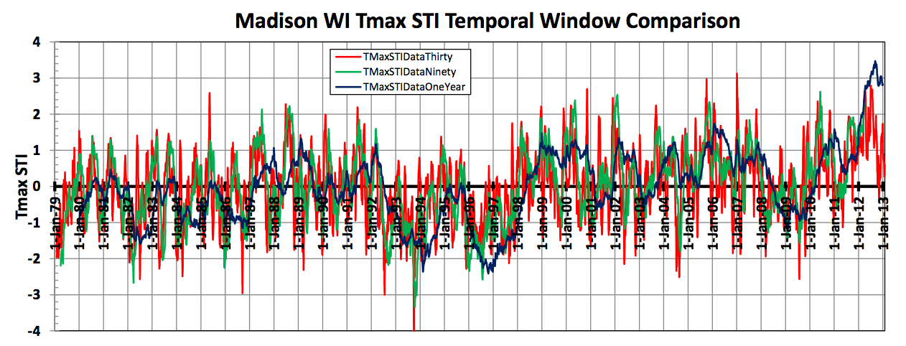
Weather variables
temperature, precipitation, soil water deficit, etc.
National Land Data Assimilation System Models
Ruben Bethke, Steve Vavrus, Volker Radeloff

Slide 23
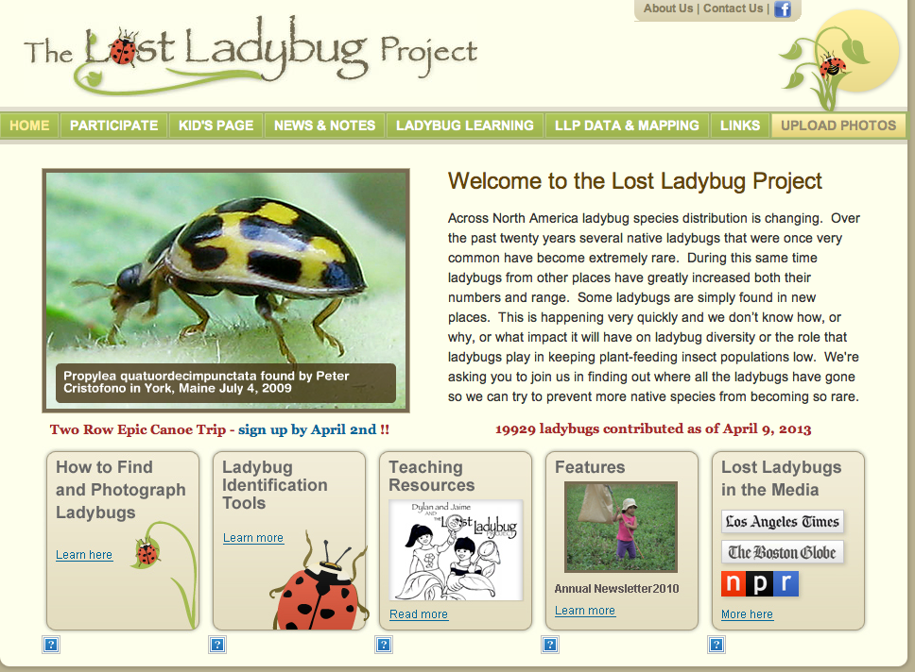
What are the regional and continental distributions of symbionts among aphids and other insects?

Slide 24
What are the regional and continental distributions of symbionts among aphids and other insects?
Citizen scientists sample for insects
Kerry Oliver assays them for symbionts
Landscape and weather context from remote sensing
Broad geographical database of symbionts to analyze for local evolutionary adaptation

Slide 25
What we want from remote sensing
How do landscape and weather combine with natural enemies to drive dynamics of pea aphids?
What are the regional and continental distributions of symbionts among aphids and other insects?
Notes:
Constrast to yesterday - theory vs. empirical
Strange talk - not going to talk about stuff that I’ve done - lab talk
Collected 12 talks given by people in the lab - condensed down to a single talk
You might be thinking that you are about to experience a 3 hour train wreck - I really did shortened things, so the train wreck should last less than 1 hour

